Slide 1






PRESENTATION 2026
Student Name
Student Email
Purneet Kaur
purneetkaur11@gmail.com
Mentor Name
uma maheshwari

Slide 2

Outline
Abstract of the Project
Problem Statement
Proposed Solution
System Architecture
Live Demo of the Project
Embedded Video of Project
Conclusion
Future Scope

Slide 3
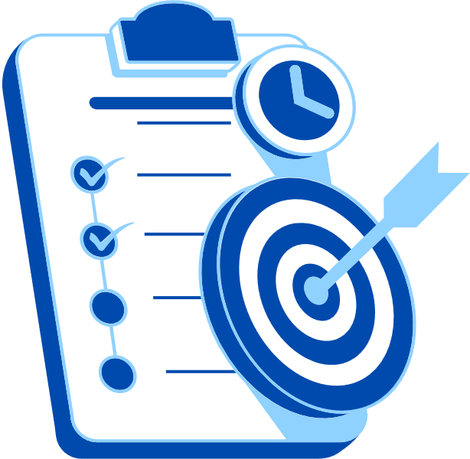
Abstract
This project focuses on generating high-quality marketing content using AI chatbots through effective prompt engineering techniques.
The project demonstrates that well-designed prompts significantly improve content quality, relevance, and engagement.
It also highlights how AI tools can save time and increase productivity in marketing tasks.

Slide 4

Problem Statement
In digital marketing, continuous content creation is essential. However, users often struggle to create effective prompts for AI tools like chatbots.
This leads to:
Low-quality or generic content
Irrelevant outputs
Lack of engagement
This problem affects:
Marketers
Students
Businesses

Slide 5

Proposed Solution
The proposed solution is to use structured prompt engineering along with a well-organized dataset.
Steps followed:
Created a dataset with marketing inputs (500+ rows)
Designed optimized prompts for different platforms
Used AI chatbot to generate content
Evaluated and improved outputs

Slide 6
System Architecture
Data Input / Source
Processing / Analysis
Dataset created in Excel
Fields: product, audience, tone, platform, keywords
Data cleaned and structured
Different prompt styles tested
AI / Tool Integration
Output / Dashboard
Tool used : ChatGPT (AI Chatbot)
Prompts used to generate marketing content
Instagram posts
Email campaigns
Website ads
Marketing copy

Slide 7

Conclusion
This project successfully demonstrates how effective prompt engineering improves AI-generated marketing content.
Key achievements:
Created structured dataset
Designed optimized prompts
Generated high-quality outputs
All objectives were achieved successfully. The project highlights the importance of structured inputs in AI systems and their impact on output quality.
CONCLUSION

Slide 8

Future Scope
Expand dataset to more industries.
Develop a prompt library for marketing
Integrate with real marketing tools
Use AI for automated campaign generation
Apply machine learning for personalization

Slide 9
Thank You
AICW Fellowship | Student Project Presentation 2026
LinkedIn | Edunet Foundation

